Slide 1
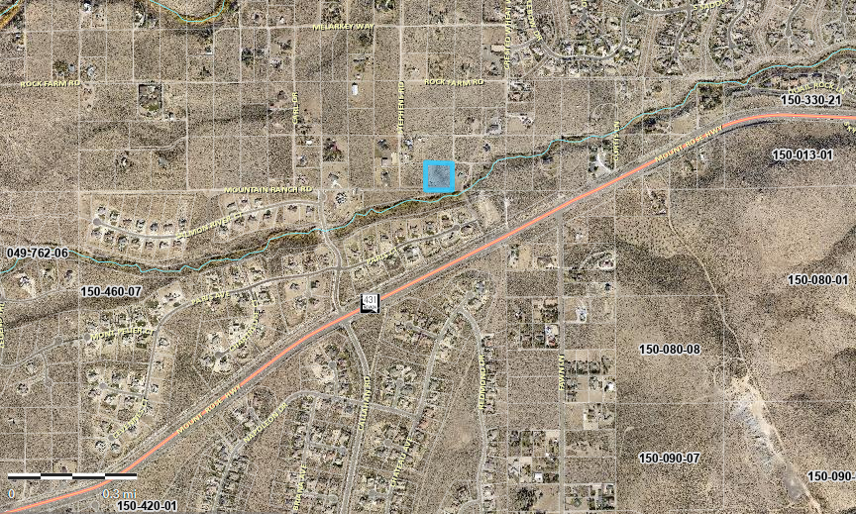
WSUP21-0004 Feulner Grading
Washoe County Planning Commission
April 6, 2021

Slide 2
Background/Request
The applicant is requesting a major grading permit for 90,000sf of ground disturbance, 3000cy of cut, 3000cy of fill, and grading within a Sensitive Stream Zone
Prior unauthorized rockery walls and mass grading.

Slide 3
Vicinity Map

Slide 4
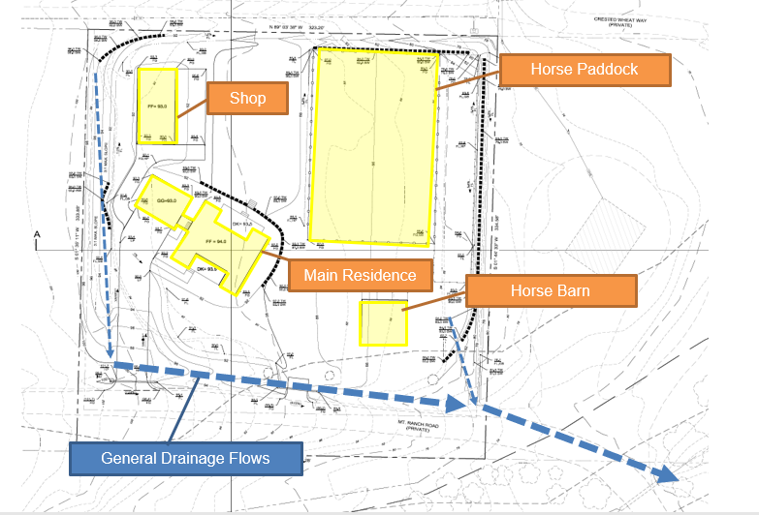
Site Plan
SSZ

Slide 5
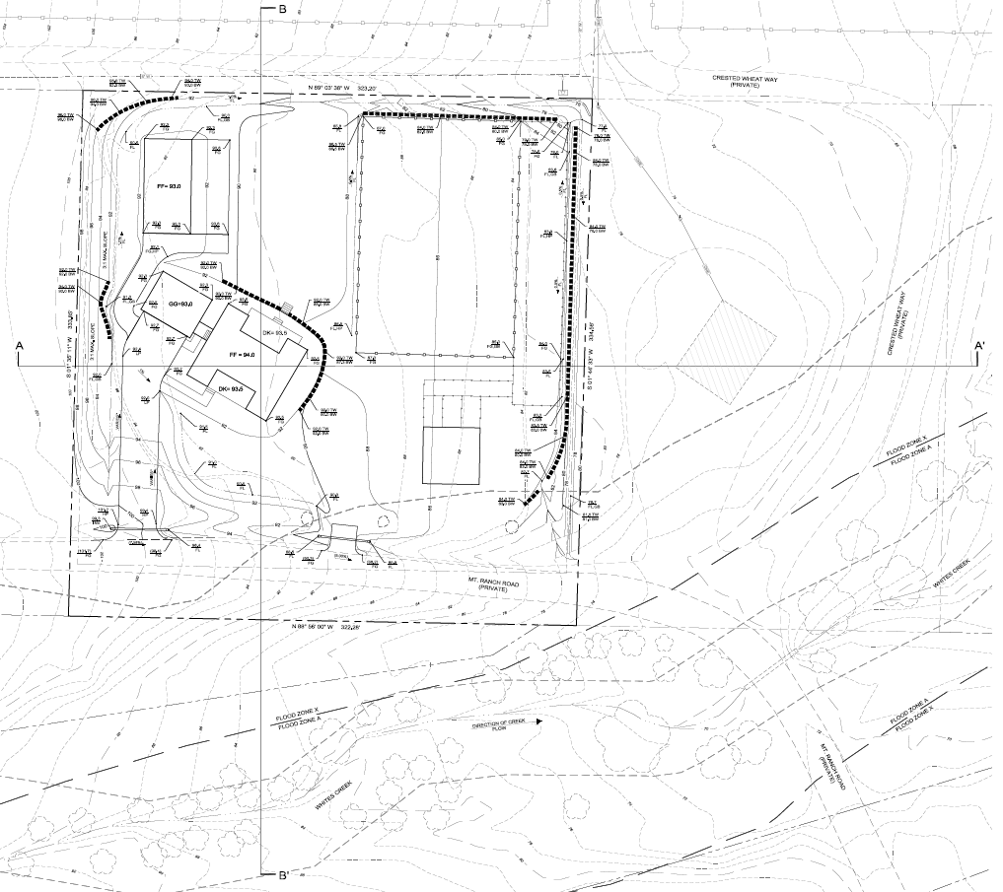
Grading Plan

Slide 6
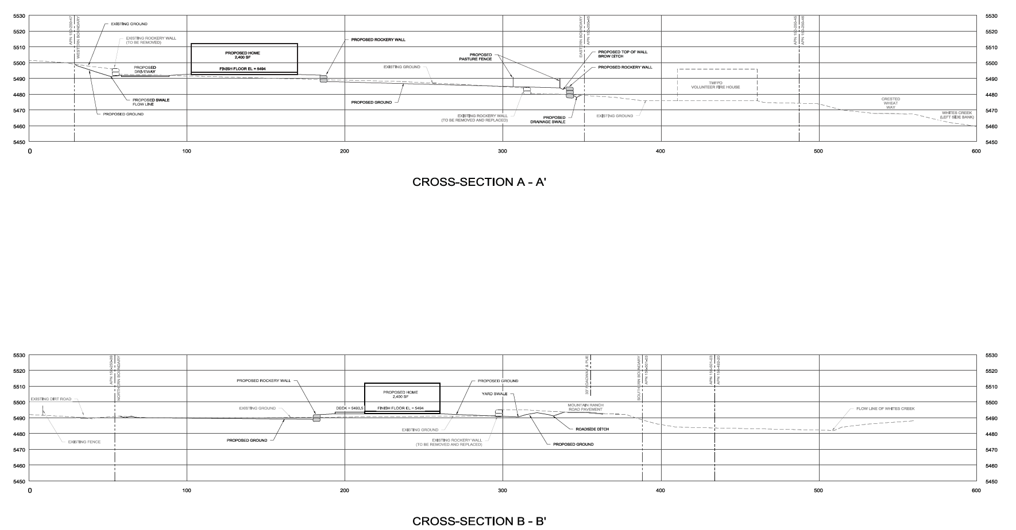
Cross Sections

Slide 7
Article 418 – Significant Hydrological Resources
Construction of a drainage ditch and driveway crossing within a Sensitive Stream Zone requires approval of a Special Use Permit
Staff has provided conditions of approval addressing in the final grading permit:
Application of best management practices to minimize stream bank/bed erosion
Prevent construction drainage and materials from increasing sedimentation impacts
Minimize impervious surfaces.

Slide 8
Article 438
Applicant is not requesting to vary any standards. Required to meet all standards per Article 438.
Application meets required slopes and retaining walls heights
Type of Regulation | Requirements
 | Front Yard | Side Yard | Rear Yard | Setback Envelope
Slopes | 3:1 | 3:1 | 3:1 | 3:1
Difference from Natural Grade | Proposed to be varied. See Exhibit A.
Retaining Wall Height | 4.5ft | 6ft Res/8ft non res | 6ft Res/8ft non res | 10ft
Retaining Wall Terrace Widths | Min. 6ft | Min. 6ft | Min. 6ft | Min. 6ft
Retaining Wall Bench Widths | Min. 4ft | Min. 4ft | Min. 4ft | Min. 4ft
Intersection Angle | 45 degrees | 45 degrees | 45 degrees | 45 degrees
Transitions | Contoured | Contoured | Contoured | Contoured

Slide 9
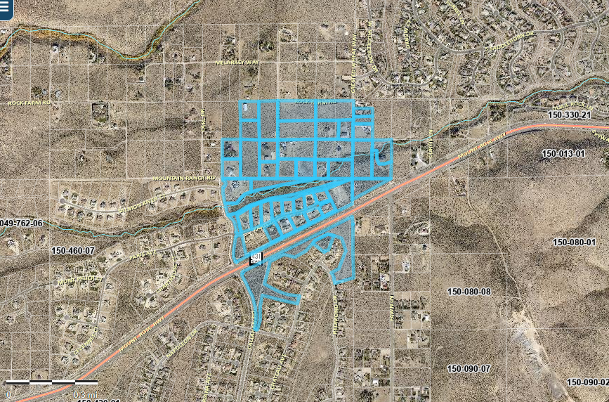
Public Notice & CAB
Notice was sent to 37 affected property owners, 1000 feet from the site.

Slide 10
Citizen Advisory Board
Proposed project presented March 4, 2021 to South Truckee Meadows/Washoe Valley CAB
CAB voiced concerns over prior un-permitted rockery walls
Voted unanimously in favor

Slide 11
Special Use Permit Findings
Consistency. That the proposed use is consistent with the action programs, policies, standards and maps of the Master Plan and the South Valleys Area Plan;
Improvements. That adequate utilities, roadway improvements, sanitation, water supply, drainage, and other necessary facilities have been provided, the proposed improvements are properly related to existing and proposed roadways, and an adequate public facilities determination has been made in accordance with Division Seven;
Site Suitability. That the site is physically suitable for child daycare, and for the intensity of such a development;
Issuance Not Detrimental. That issuance of the permit will not be significantly detrimental to the public health, safety or welfare; injurious to the property or improvements of adjacent properties; or detrimental to the character of the surrounding area;
Effect on a Military Installation. Issuance of the permit will not have a detrimental effect on the location, purpose or mission of the military installation.

Slide 12
Recommendation
Those agencies which reviewed the application recommended conditions to address applicable codes and impacts associated with the project. After a thorough analysis and review, staff recommends that the Planning Commission carefully consider all aspects of Special Use Permit Case Number WSUP21-0004 and the nature of the stringent recommended conditions of approval and approve the requested Special Use Permit.

Slide 13
Possible Motion
APPROVAL: I move that, after giving reasoned consideration to the information contained in the staff report and information received during the public hearing, the Washoe County Planning Commission approve with conditions Special Use Permit Case Number WSUP21-0004 for Christopher and Megan Feulner, with the conditions included as Exhibit A to this matter, having made all five findings in accordance with Washoe County Code Section 110.810.30

